Slide 1

Social Network Analysis Project
Using Amazon product co-purchasing network
Jiaqi Guo
Xiaoyuan Deng
Jiadai Pang
Qing Lin
Notes:
Hi, my name is jacky, My teammates and I will introduce about our Snap Project in this video. I hope you enjoy!

Slide 2
Contents
Data Description
In-depth Questions we want to answer
Result Analysis(from both macro and micro perspectives)
Our Finding
Notes:
First, to give you a sense of what we're doing. I will list the outline of this video, which contains four parts, which is Data description, Our research questions, A result analysis and a summary of our findings. And, as the first person presenting, I will talk about our data preprocessing process.

Slide 3
Data Description
Data Pre-processing
Data Format:
ID: product id information
ASIN: Amazon Standard Identification Number
Title: Name/Title of the Product
Group: Product Group (book, video, DVD…)
Salesrank: The Popularity of the Product
Similar: Co-Purchased Product (People who buy X also buy Y)
Categories: Location in product category hierarchy
Reviews: Product review information (number of reviews, rating…)
Assigning group labels:
Book: 1 Music: 2 DVD: 3 Video: 4 Others: 0
Assigning Salesrank values:
Top 10%: 3 Top 20%: 2 Top 50%: 1 Others:0
Assigning rating labels (max 5):
Above 3: 1 (high) Below 3: 0 (low)
Notes:
Our dataset contained eight sorts of information, ID, Amazon standard identification number, Title, Groups, SalesRank, Similar, Categories, Reviews. We first derive the adjacent matrix of the graph using the ID, Similar and Amazon standard identification number. Then we digitize the remaining parameters(***), that is, we discretize the continuous variables into several value zones. For example, we labeled the top 10% products in the salesrank to be 1, and 20 percent to be 2. Such operations greatly reduced the parameter complexity, and almost doubles the convergence rate of the model.

Slide 4
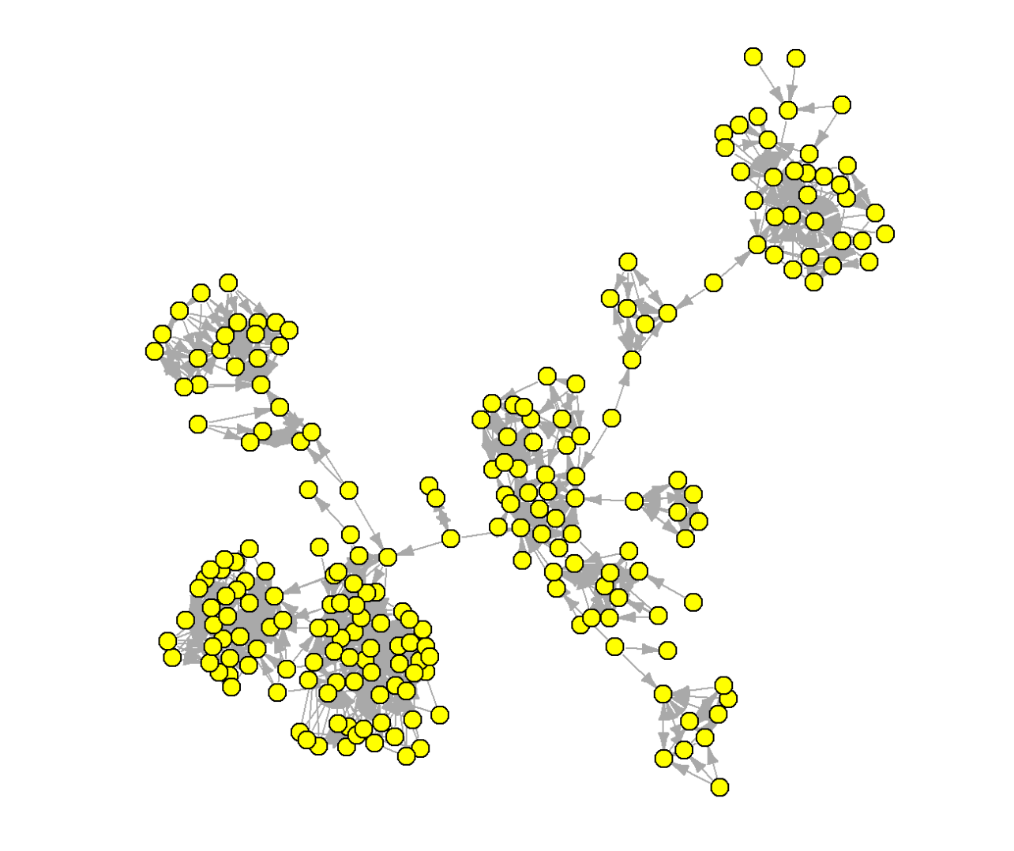
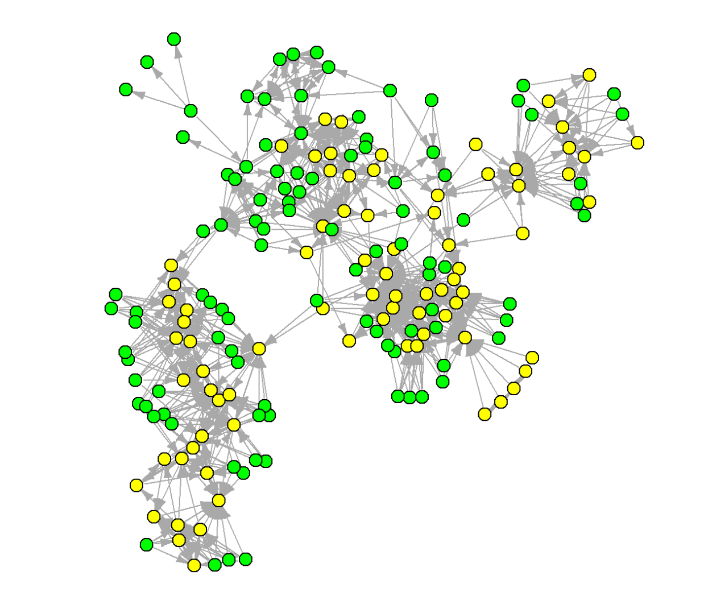
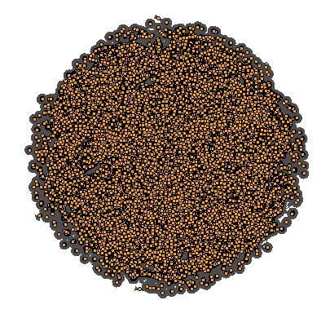
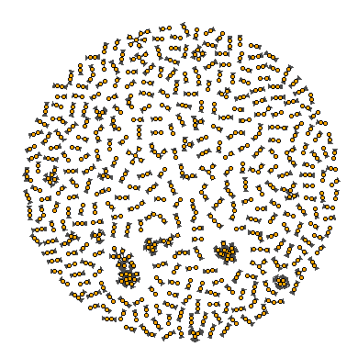
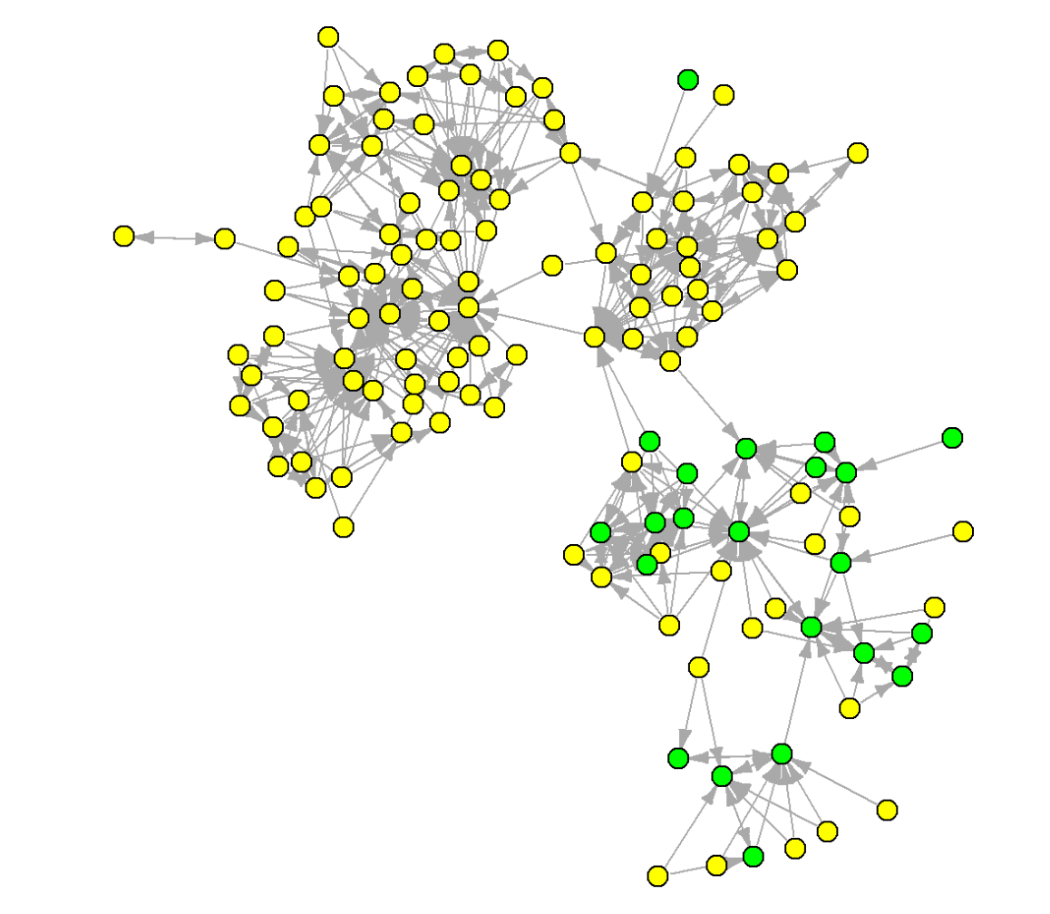
Data Description
Data Cleaning
2-th
222 nodes
Book
3-th
184 nodes
Video+DVD
Raw Data
Down sampling
4-th
131 nodes
Video+DVD
Extract the 5 Largest Components
Notes:
After the visualization, One interesting finding is that among the top five giant Components, only the largest giant Component contains more than 3 kinds of products. And for the rest of the four giant components, we can find Video and DvD usually come in pairs, suggesting a certain correlation between them, while books always come alone.

Slide 5
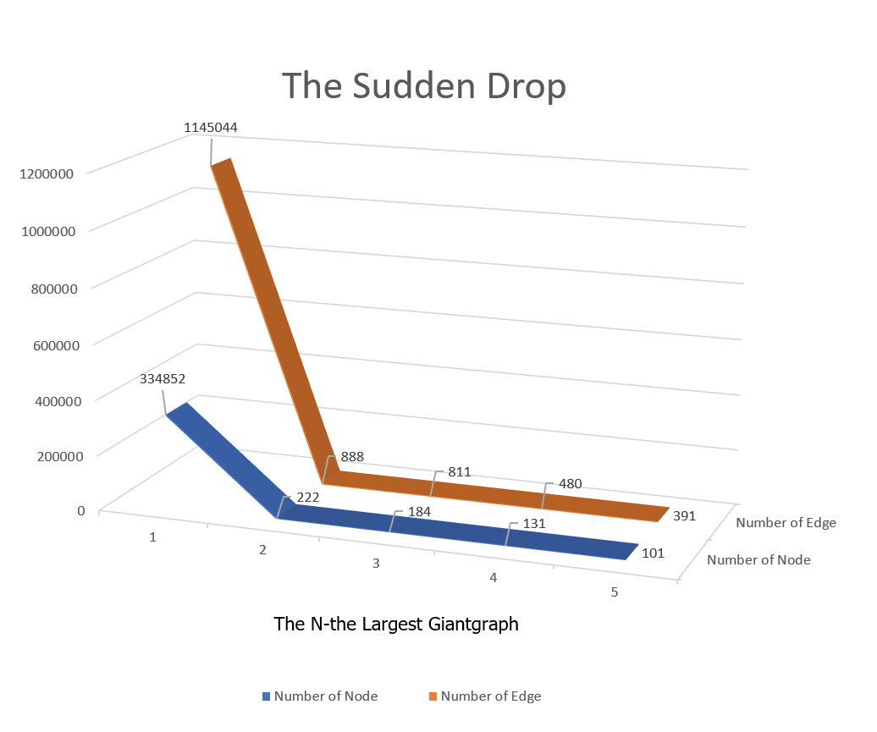
The node number is dropping from 33482 to 222.
The edge number is dropping from 1145044 to 888.
And, our research will be conducted based on those “Giant” Components…
Notes:
Another interesting finding is that, There is a huge difference in size between the largest and the rest of the giant Components. The node number even suddenly drop from three hundred and thirty thousand to 222. Most of Our further researches will be conducted based on those micro communities in the network. And lets welcome my next teammate to tell you the in depth question that we want to answer.

Slide 6
In-depth questions we want to answer…
1. Can we identify the top 5 largest connected component of the dataset, what are the characteristics?
2. What are the density and connectedness of the co-purchase network?
3. What are the bundles of products that are sold together, according to the degree centrality, clustering coefficient and sales rank of the products?
Notes:
Because the dataset is too huge, it is impossible to analyze the whole data set, so we want to focus on the largest connected component.
We believe that the largest component can reflect the characteristics and features of the whole dataset.

Slide 7
4. Can we pinpoint and evaluate communities and clusters in the graph, based on the ERGM and ALAAM model?
5. What factors can determine the sales rank of a product? We will use linear regression model to predict the sales rank, based on the Average Rating, Degree Centrality, Clustering Coefficient and number of reviews of a product.
6. What are the most popular products? Can we find the product with the highest degree centrality and clustering coefficient?
Notes:
5.We use a linear regression model to predict the sales rank, based on four variables we chose.
What factors can determine the sales rank of a product? Will Average Rating, Degree Centrality, Clustering Coefficient and number of reviews play a role? Is the relationship positive or negative.
6.What are the most popular products? Can we find the product with the highest degree centrality and clustering coefficient. This will provide some insights for marketing and sales department, they can put the most popular products on the front page, make them a highlight and therefore drive sales.

Slide 8
Analysis - ERGM Model
Objective: determine what node attributes influence customer co-buying behaviors
Node attributes: indegree, outdegree, groups, reviews_num, avg_rating, salesrank
Endogenous Effects: gwidegree/gwodegree
Exogenous Effects: nodeicov, nodeocov, nodematch

Slide 9
Analysis - ERGM Model
Node attributes | Hypothesis
gwidegree/gwodegree | Indegree/outdegree popularity effects
nodematch(“product group”) | tendency to co-buy products in the same product group
nodematch("reviews_num") | tendency to co-buy products with similar reviews_nunber
nodematch("avg_rating") | tendency to co-buy products with similar avg_rating
nodematch("salesrank") | tendency to co-buy products with similar sales_rank
nodeicov("avg_rating/salesrank") nodeocov("avg_rating/salesrank") | tendency to co-buy “the most common_co_buy” product tendency to be co-bought refer to “avg_rating/salesrank”

Slide 10
Analysis - ALAAM Model
Objective: determine the relationship between attributes and the contagion of certain attribute.
Node attributes: indegree, outdegree, reviews_num, avg_rating
Dependent variable: Ranking 10 (top 10% high sales rank)
Specific question to explore: How indegree, outdegree, reviews_num, avg_rating (network ties) may influence the sales rank(node attribute).
Notes:
The second model we are going to use is the Alaam model. The objective is to determine the relationship between attributes and the contagion of certain attributes. There are 4 node attributes, indegree, outdegree, review_nums and avg_rating. The dependent variable we chose is the sales ranking, because the dataset is so huge, so we focus on the top 10% high sales ranks of products. They are also the best-selling products.

Slide 11
Analysis - Linear Regression Model
Objective: determine the relationship between node attributes and the sales rank
Positive/Negative
y = β * x + e
salesrank
review_num, avg_rating
degree_centrality
clustering_coeff
Modelling result: top 10 products recommendation
Notes:
Next we are going to use a linear regression model to determine the relationship between node attributes and the sales rank. It is simple and easy to model a relationship, and can also give us a broader and bigger picture of the variables in our data set.

Slide 12
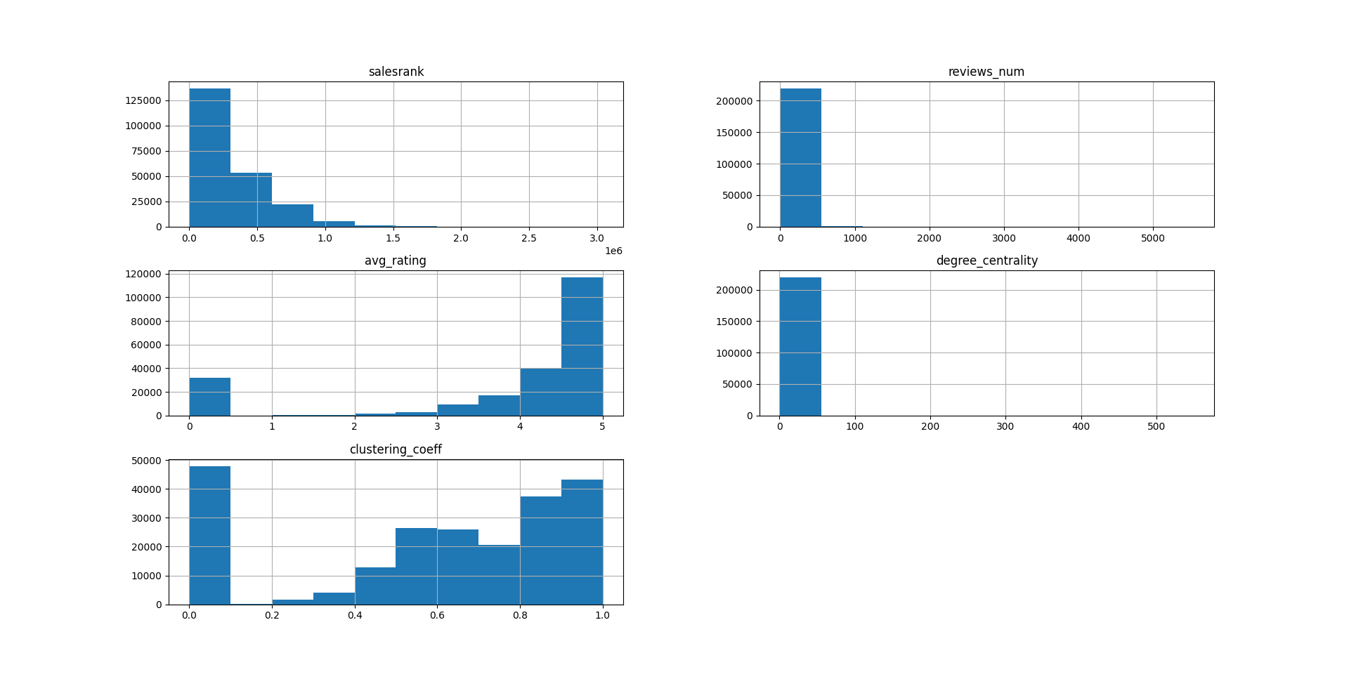
Analysis- Linear regression visualization
Notes:
In terms of average rating, 5 means the highest while 1 means the lowest. We also noticed that some products have zero ratings, which means they are outliers.
We can see that a very small number of nodes have higher than 0 degree centrality, which means that these nodes are more centred compared to the majority of the products. We have to pay attention to those nodes with higher degree centrality, because they could be an influencer or a catalyst product.
For clustering co-efficient, we noticed many products in the amazon co-purchase dataset have a clustering coefficient higher than 0.2, which means they tend to cluster together/ be bought together with other products. So the marketing and sales department can target those products to drive sales for other products which has high density of ties.

Slide 13
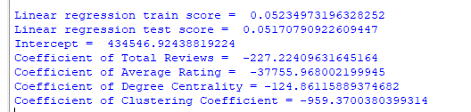
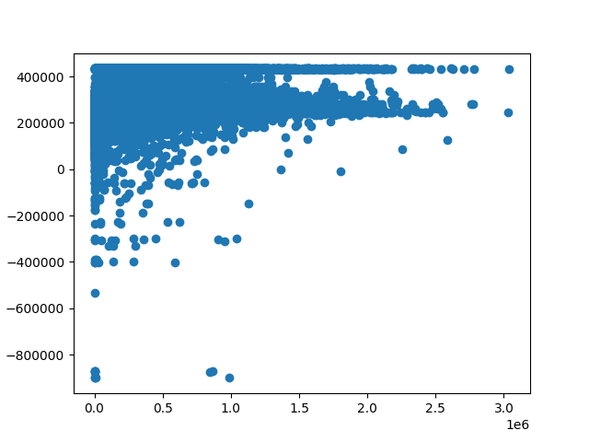
Analysis - Linear regression
Notes:
The Amazon sales rank is a number that represents the item’s popularity in a main category or sub-category. Every product on Amazon receives a ranking for its sub-categories, but the rank can be updated frequently. so, sales rank shows how well a product is selling relative to other products, 1 is the best-selling product, and 1000 is the No.1000 best seller. The smaller the number, the better.
We want to build a linear model to look at the broader and bigger picture of the relationship between different variables. We use sales rank as the dependent/response variable and there are 4 predictor/independent variables, such as the total reviews, average rating, degree centrality and clustering coefficient of the products.
As mentioned before, lower rank implies higher sales. So It is natural to expect that the coefficients are negative, because as the values increase, the model must produce a lower rank.

Slide 14
Use clustering coefficient and degree centrality to measure the popularity of a product.
Top 10 Products with highest clustering coefficient
node_id group clustering_coeff title
502283 Book 1.0 The Little Green Book: Questions for Radiology Conference
531698 Book 1.0 Jesus of Cool
324644 Book 1.0 Hack/Liminality Original Soundtrack Plus
469837 Book 1.0 150 Extra-Easy Ornaments in Plastic Canvas
469835 Book 1.0 The New Pioneers: The Men and Women Who
240513 Book 1.0 Patty's Pumpkin Patch
431805 Book 1.0 Striper Surf
69212 Book 1.0 The Joffrey Ballet School's Ballet-Fit
240521 Book 1.0 The Insiders' Guide to Virginia Beach
531693 Music 1.0 Labour of Lust
Notes:
Degree centrality and clustering coefficient are good metrics to measure the popularity of a product.

Slide 15
Top 10 products with highest degree centrality
node_id group degree_centrality title
1072 Book 549 Easter Story Keepers
5441 Book 324 The Complete Book of Palmistry
7236 Book 257 Myocardial Infarction: An Incredibly Easy! Miniguide
1851 DVD 230 Economic Development (8th Edition)
34099 Music 228 Carpe Diem
5231 Book 219 Julian the Apostate
9276 Book 217 The Adventures of Sherlock Holmes
36551 Music 212 Studs Terkel's Working (Broadway Theatre Archive)
9641 Book 205 Kindred of the East (For Vampire, the Masquerade)
3901 Book 197 Fashion Merchandising and Marketing

Slide 16
Findings for ERGM
The contents in the red box are typical examples of some of the results
Mutual co-purchase relation often appears according to EGRM mutual score
For DVDs and Videos, they are less likely to be co-purchased from the same product group (node match)
3. There is indegree popularity effect, which means if a product is already co-purchased frequently, it is more likely that this product will be co-purchased again.
Notes:
Firstly, mutual co-purchase relation often appears according to EGRM mutual score. We can see a positive mutual estimate value, which means the possibility of having a mutual tie is higher.
This is supported by the EGRM model, from which we can see none of these components shows a positive estimate group node match value, which means if a people buys a DVD, he will not likely continue to buy another DVD
The negative dwideg values proves that.

Slide 17


Findings for ALAAM & Linear Regression
There is positive correlation between degree centrality and Sales Rank, which is supported by both ALAAM model and linear regression.
There is contagion effect on sales rank. if a product has a high rank, the products that are co-purchased are more likely to also have a high rank.
Notes:
From the data of linear regression we can see negative coefficient value, because we used the original rank data, the smaller the higher
We can also see the similar result from ALAAM model by setting up a dependent variable of whether this product is the top 10% well sold, we get a positive relation. We believe it’s a good sign
From the ALAAM model we can see the 95% confidence interval does not cross zero

Slide 18
Suggestions
If you want to make a recommendation, you can recommend a popular product from similar category, with comparable characteristics and features.
Locating the most valuable co-purchase recommendation by sales rank
Indegree popularity effects + positive correlation between degree centrality and sales rank
Contagion effect, high-sales rank products are bundled together.
Notes:
From our findings above, the first recommendation we’d like to make is …
Because the real co-purchase often happens between books, or similar groups like DVDs & Videos. For books, we can recommend also books but with similar topics. And for the DVDs & Videos, we’d better recommend products from different group because of the negative node match score in ERGM we mentioned before.
the second suggestion is
We made this suggestion for two reasons:
One is that the the indegree popularity effect reflects the value of the product with high indegree. People often co-purchase the most popular product. And because of the relation between degree centrality and sales rank, we can find the high centrality product by sales rank if we don’t have the whole network data.
Another reason is that the contagion effect tells us that since high-sales products are bundled together, the best product recommendation for a high sale product is another high-sale one

Slide 19
Thank you for your attention!

